Slide 1
服務分享
Volunteer Work

Slide 2



Slide 3
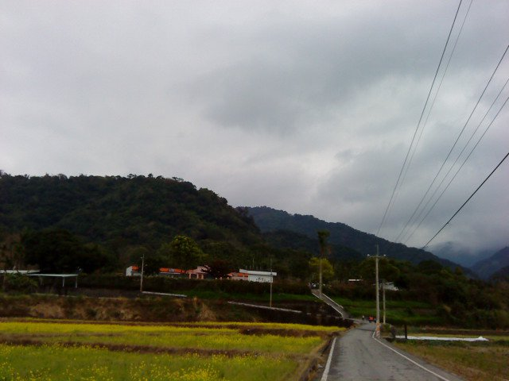
世界上本來是沒有道路的，是一群人朝這同樣的目標前進才走出路來的。
There used to be no roads at all; however, if a group of people walk towards the same goal, naturally the road will form itself.
李維元
Dr. Wesley Lee

Slide 4
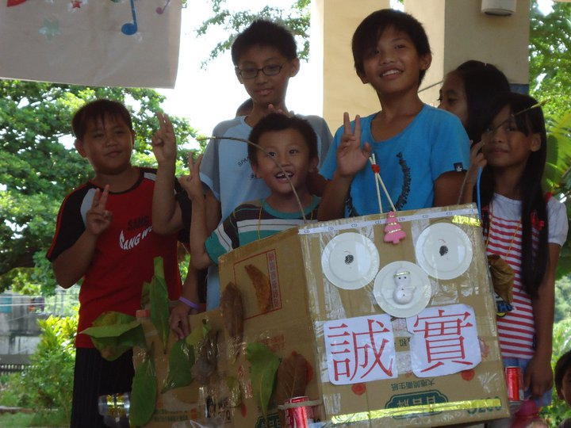
Educational Volunteering

Slide 5
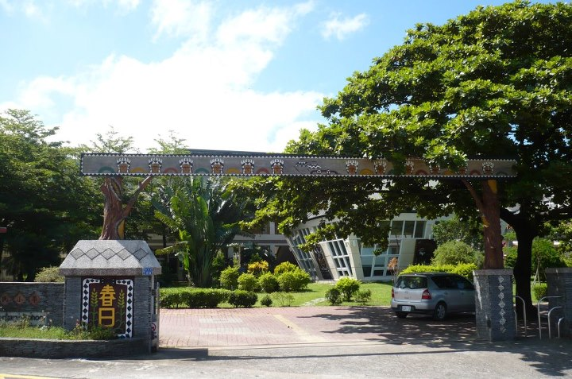

Slide 6
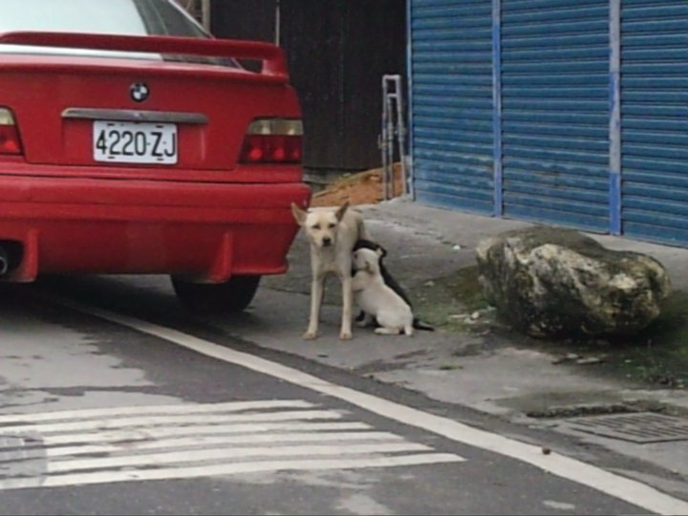

Slide 7
What we do
Accommodate those who are lonely.
Share knowledge.
Give the children their childhood back.
Bring happiness and memories.
Share our spirit.

Slide 8
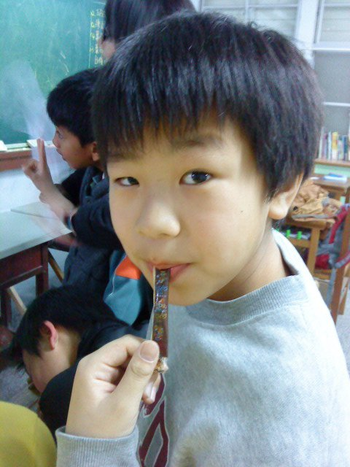
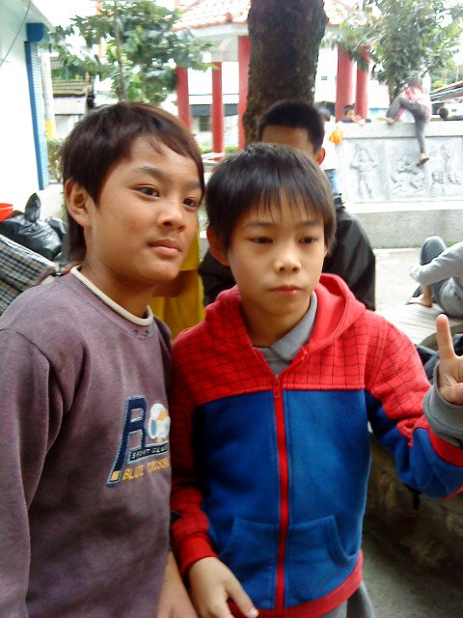
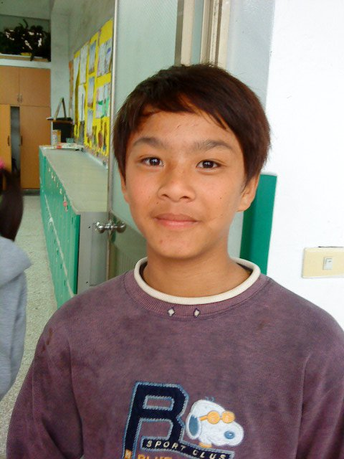
Who
Elementary
Indigenous Children

Slide 9
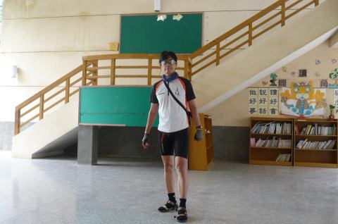
And of course…

Slide 10
Behind the scenes
Pros
Laziness
Homesick
Temptation
Perseverance
Lack of PATIENCE
Cons

Slide 11
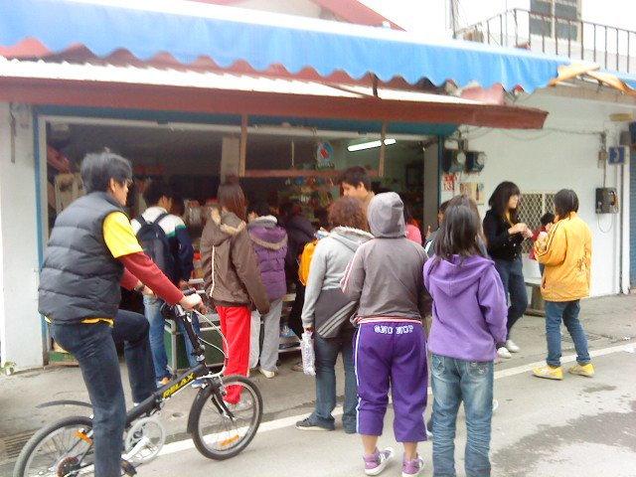
Evil teachers outside of school
Nah, kidding

Slide 12
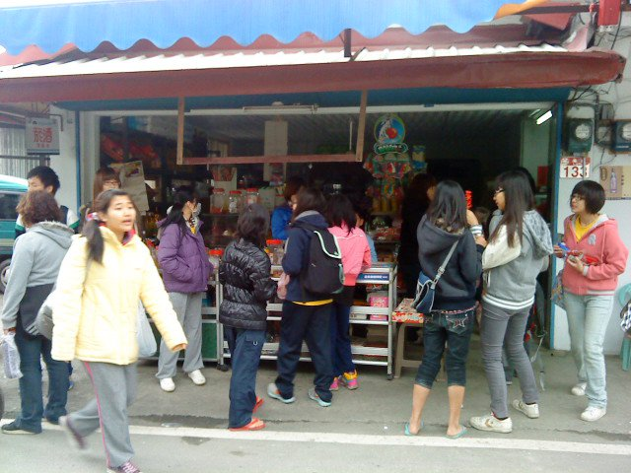
Supplements

Slide 13
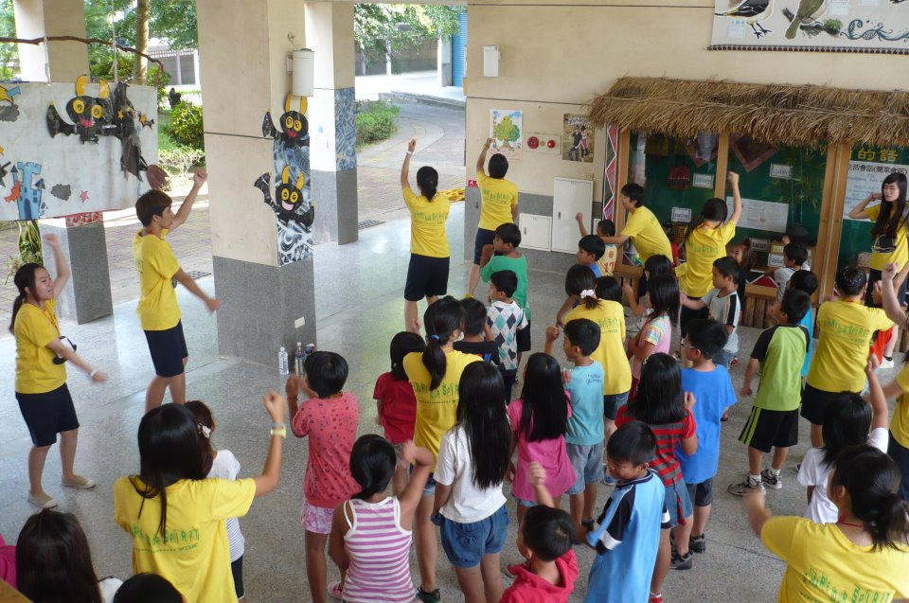
Everybody likes Kung-Fu fighting~~Ah! Ooh!

Slide 14
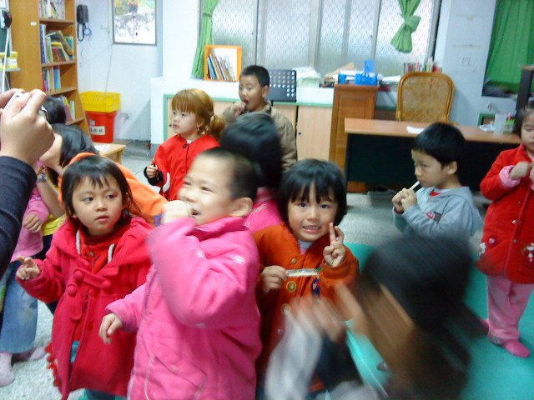
Sessions
English
PE
Reading
Craft
Theater

Slide 15
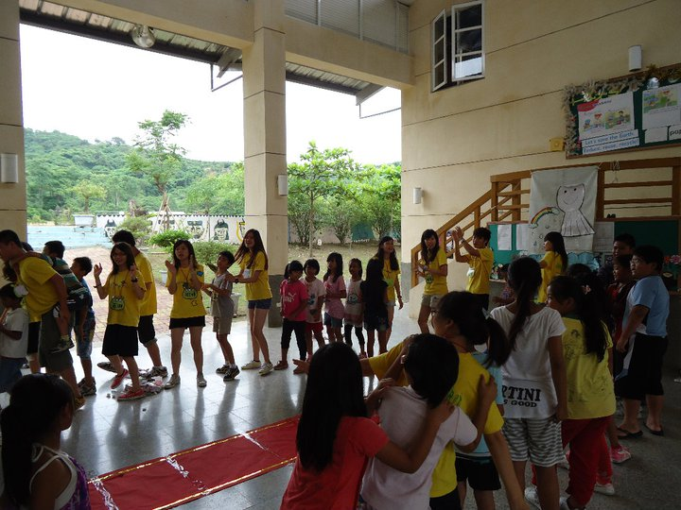
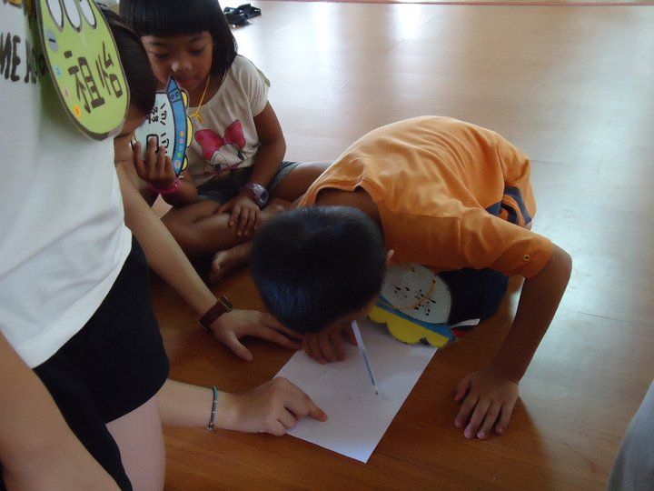
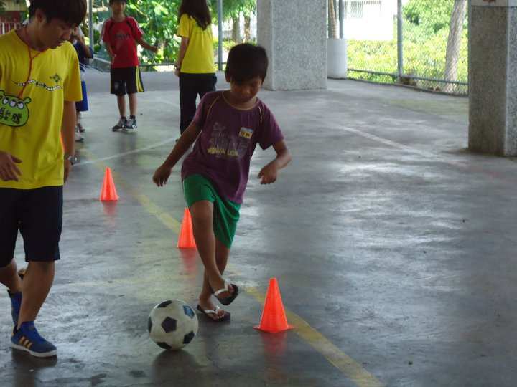
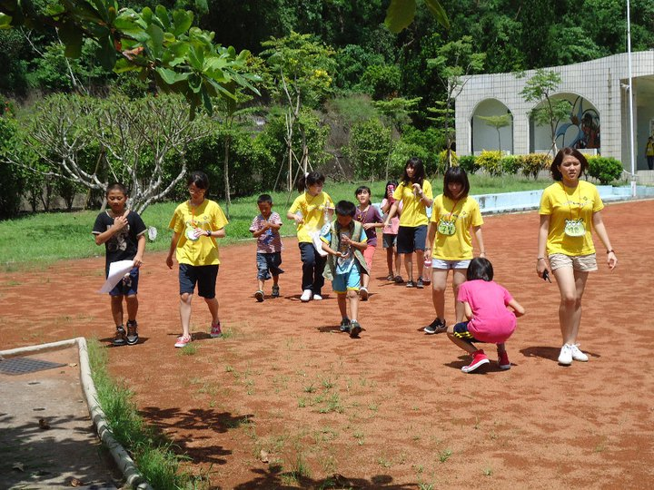
Activities

Slide 16
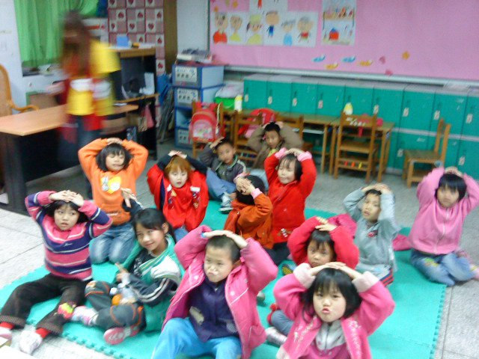
DISCIPLINE…

Slide 17
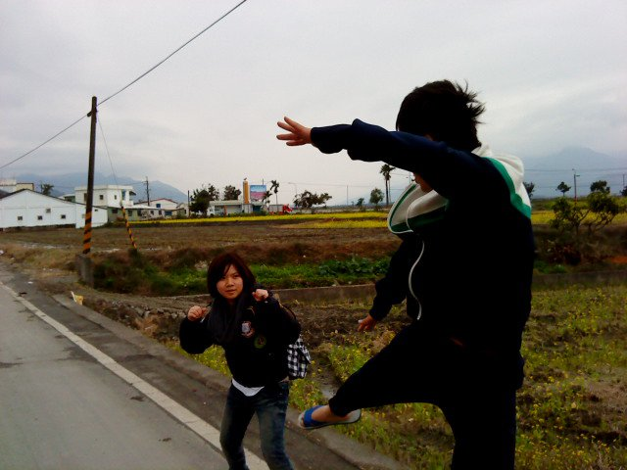
Consequences

Slide 18
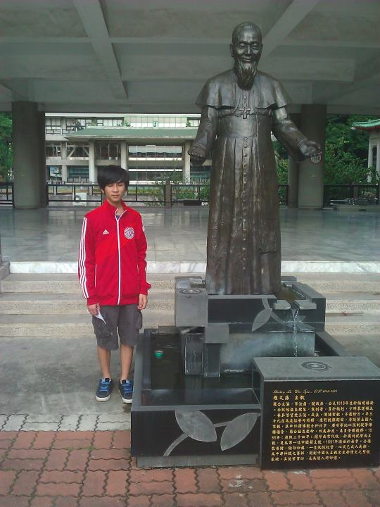

Slide 19
What I’ve Learned
Leadership
Independence
Tolerance
Generosity
Responsibility
Self-Evaluation
Self-Control
Teamwork
Perseverance
Mature

Slide 20
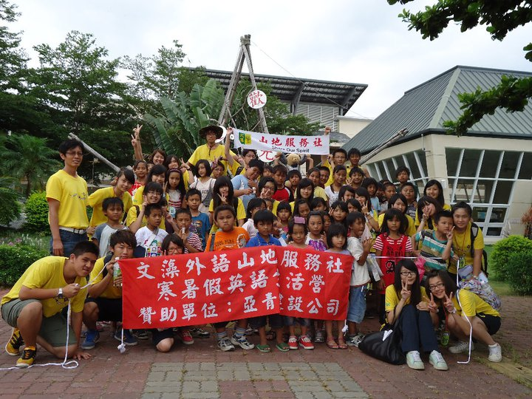
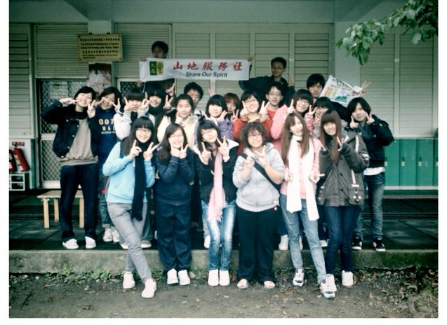
That’s all Folks!

